Slide 1


SQL PROJECT
TRAVEL ITINERARY PLANNER
DANISH DIVEKAR

Slide 2





INTRODUCTION
This innovative tool simplifies travel planning with the power of SQL, making trip organization efficient and accessible to all.

Slide 3

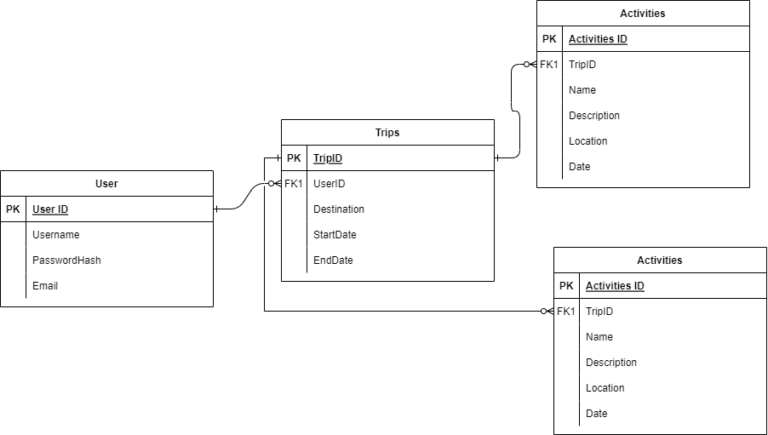
ER MODEL

Slide 4



DATABASE DESIGN
DATABASE:
TRAVEL_ITINERARY_PLANNER
TABLES:
USERS
TRIPS
ACTIVITIES
FLIGHTS

Slide 5

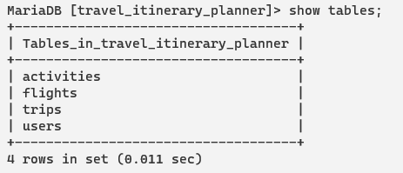
SYNTAX: SHOW TABLES;

Slide 6
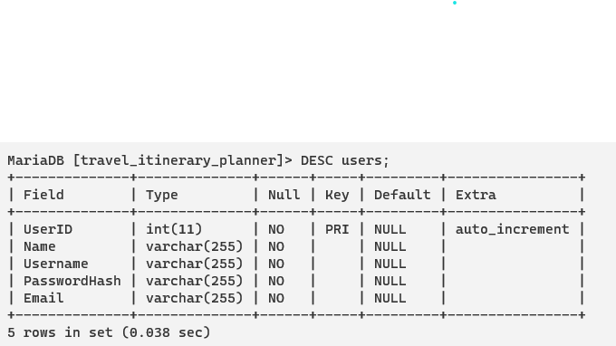
SYNTAX: DESC USERS;
#Structure of Table

Slide 7
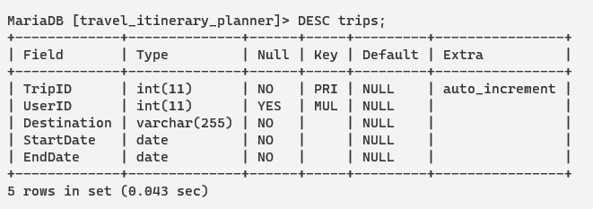
SYNTAX: DESC TRIPS;

Slide 8
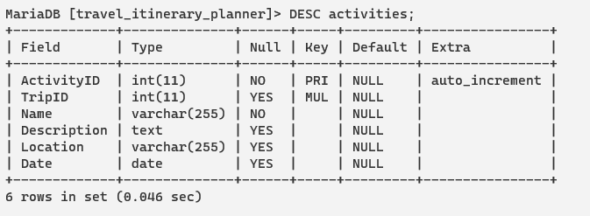
SYNTAX: DESC ACTIVITIES;

Slide 9
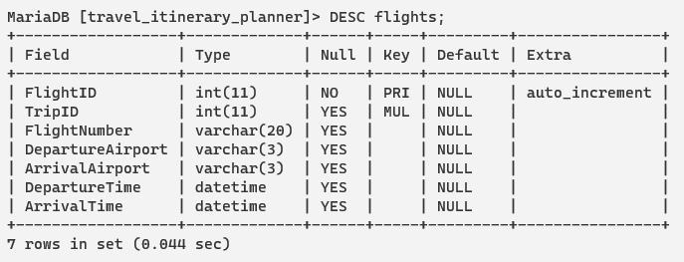
SYNTAX: DESC FLIGHTS;

Slide 10
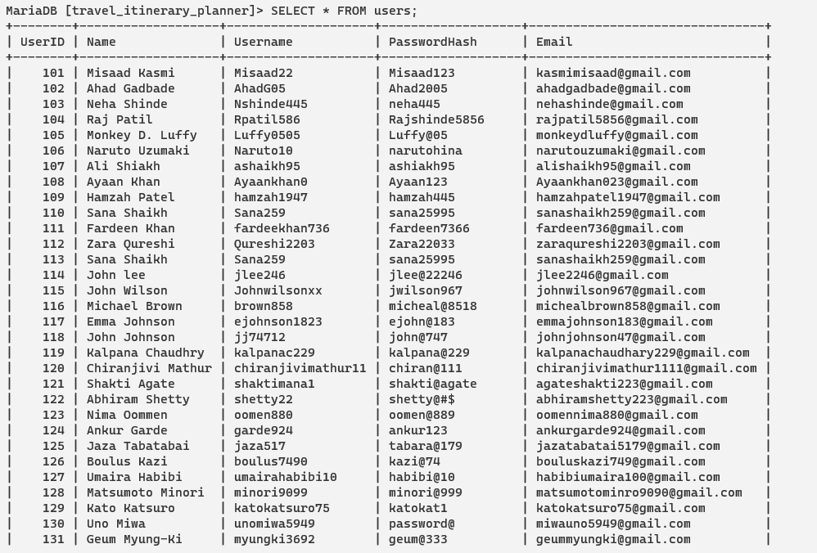
SYNTAX: SELECT * FROM USERS;
SELECT is a clause used to fetch data from a table
U
S
E
R
D
E
T
A
I
L
S

Slide 11
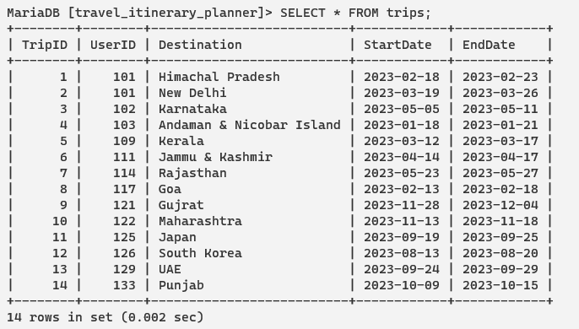
SYNTAX: SELECT * FROM TRIPS;
T
R
I
P
D
E
T
A
I
L
S

Slide 12
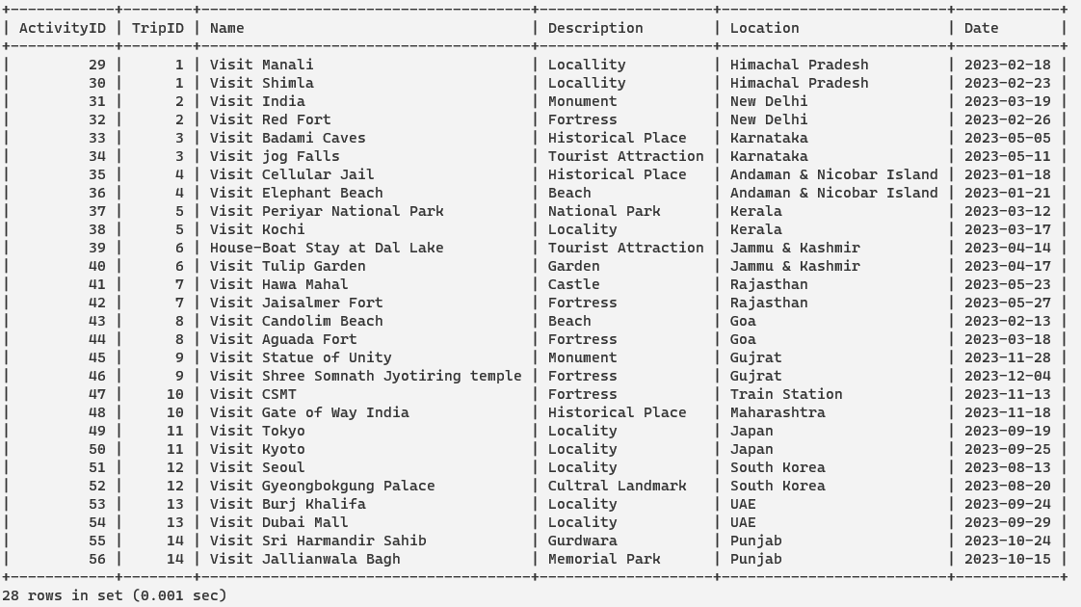
SYNTAX: SELECT * FROM ACTIVITIES;
A
C
T
I
V
I
T
I
E
S
D
E
T
A
I
L
S

Slide 13
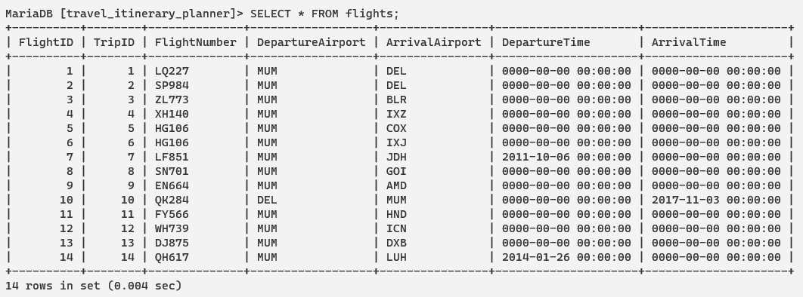
SYNTAX: SELECT * FROM FLIGHTS;
FLIGHTS DETAILS

Slide 14
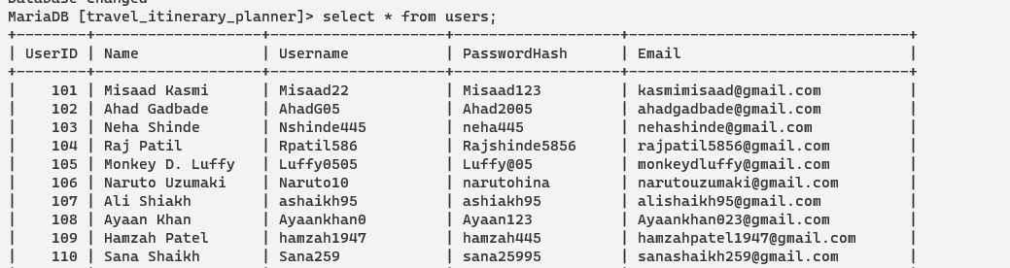
SYNTAX: UPDATE users SET PASSWORDHASH="Misaad@123" WHERE UserID=101;
UPDATE IS A CLAUSE USED TO MODIFY EXISTING RECORD IN A DATABASE TABLE
#BEFORE UPDATE

Slide 15
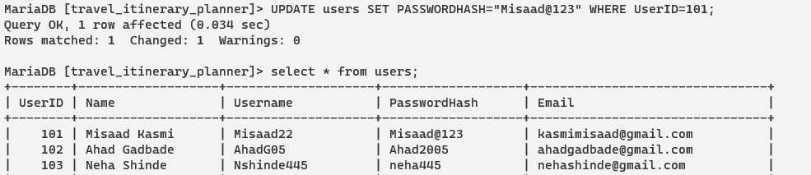

AFTER UPDATE

Slide 16
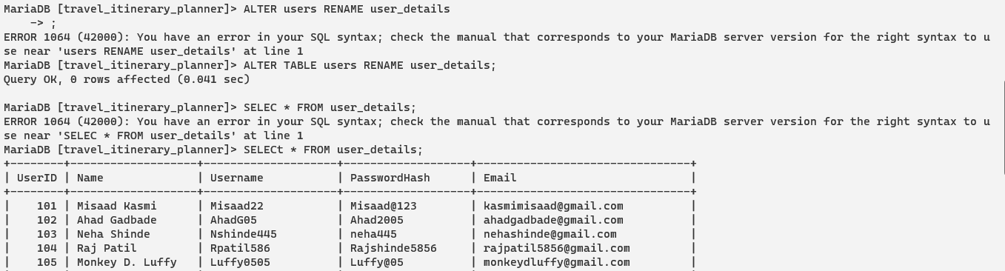
SYNTAX: ALTER TABLE USERS RENAME USER_DETAILS;
ALTER IS A KEYWORD TO MODIFY THE STRUCTURE OF AN EXISTING DATABASE OBJECT SUCH AS TABLE, VIEW OR INDEX

Slide 17
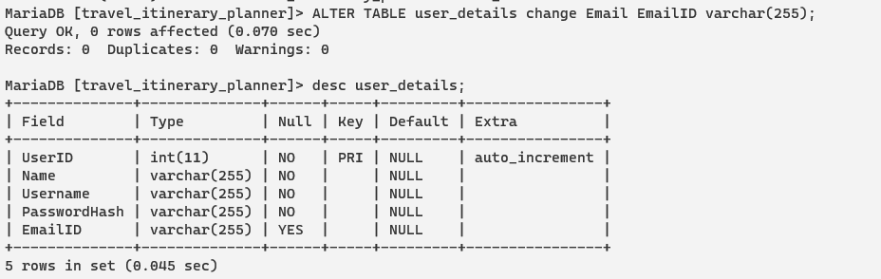
SYNTAX: ALTER TABLE USER_DETAILS CHANGE EMAIL EMAILID VARCHAR(255);

Slide 18
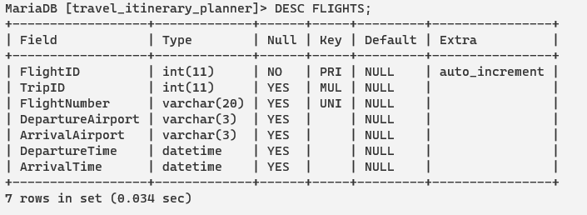
SYNTAX: ALTER TABLE FLIGHTS ADD UNIQUE KEY FLIGHT NUMBER;
UNIQUE CONSTRAINT OR UNIQUE KEY IS A TRYPE OF CONSTRAINT USED TO ENFORCE UNIQUENESS ON THE VALUES OF ONE OR MORE COLUMNS IN A TABLE

Slide 19
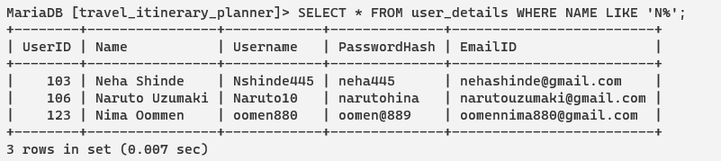
SYNTAX: SELECT * USER_DETAILS WHERE NAME LIKE ‘N%’;
LIKE OPERATOR IS USED IN THE WHERE CLAUSE OF A QUERY TO PERFORM PATERN MATCHING ON A COLUMN VALUES. IT ALLOWS TO SEARCH ROWS IN A TABLE THAT MATCH SPECIFIC PATTERN OR SUBSTRING

Slide 20
SYNTAX: SELECT * FROM USER_DETAILS LEFT JOIN TRIPS ON USER_DETAILS.USERID=TRIPS.USERID;
THE "LEFT JOIN" COMBINES ROWS FROM TWO TABLES BASED ON A COMMON KEY, RETRIEVING ALL RECORDS FROM THE LEFT TABLE AND MATCHING ONES FROM THE RIGHT.

Slide 21
TRIP DETAILS
USER DETAILS

Slide 22
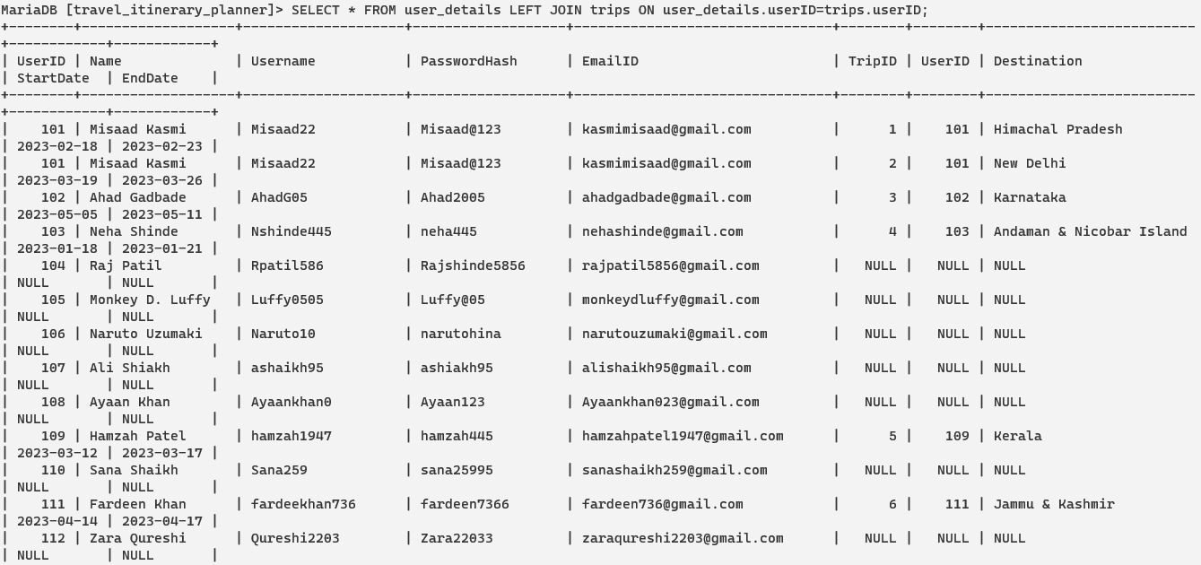
AFTER LEFT JOIN

Slide 23


Thank You

